Slide 1
Soil nitrogen availability increases the positive effect of aridity on water use efficiency
Evan A. Perkowski; Nicholas G. Smith
Texas Tech University

Slide 2
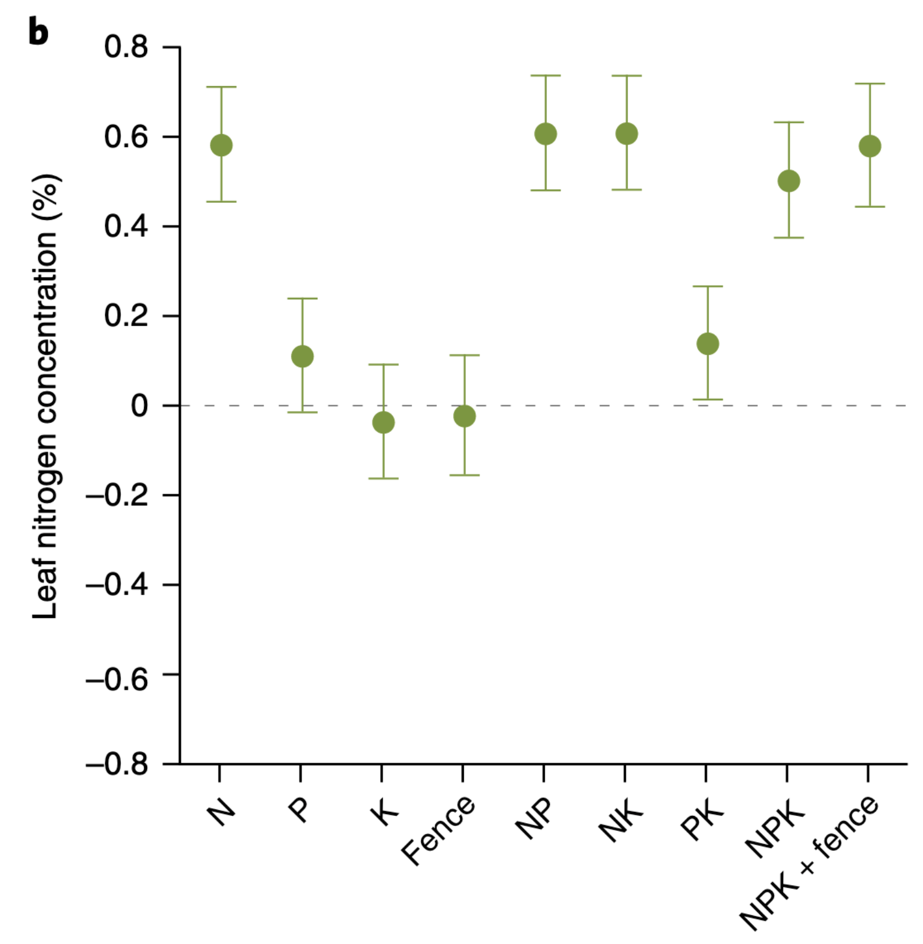
Soil nitrogen generally increases leaf nitrogen
Firn et al. (2019) Nature
Notes:
Soil nitrogen has been shown to positively influence leaf nitrogen in a fair share of studies.
This figure is from a study by Jenn Firn in 2019 using a globally coordinated nutrient addition experiment by the name Nutrient Network.
In these experiments, nitrogen, phosphorus, and potassium are added in a full-factorial field manipulation in grassland systems
On the x-axis is the different combinations of nutrient additions, and on the y-axis is leaf nitrogen concentrations

Slide 3
Soil nitrogen generally increases leaf nitrogen
Plots that receive nitrogen have higher leaf nitrogen content
Firn et al. (2019) Nature
Notes:
You can see that there is a pretty obvious increase in leaf nitrogen content in plots that receive nitrogen fertilizer regardless of potassium and phosphorus combinations

Slide 4
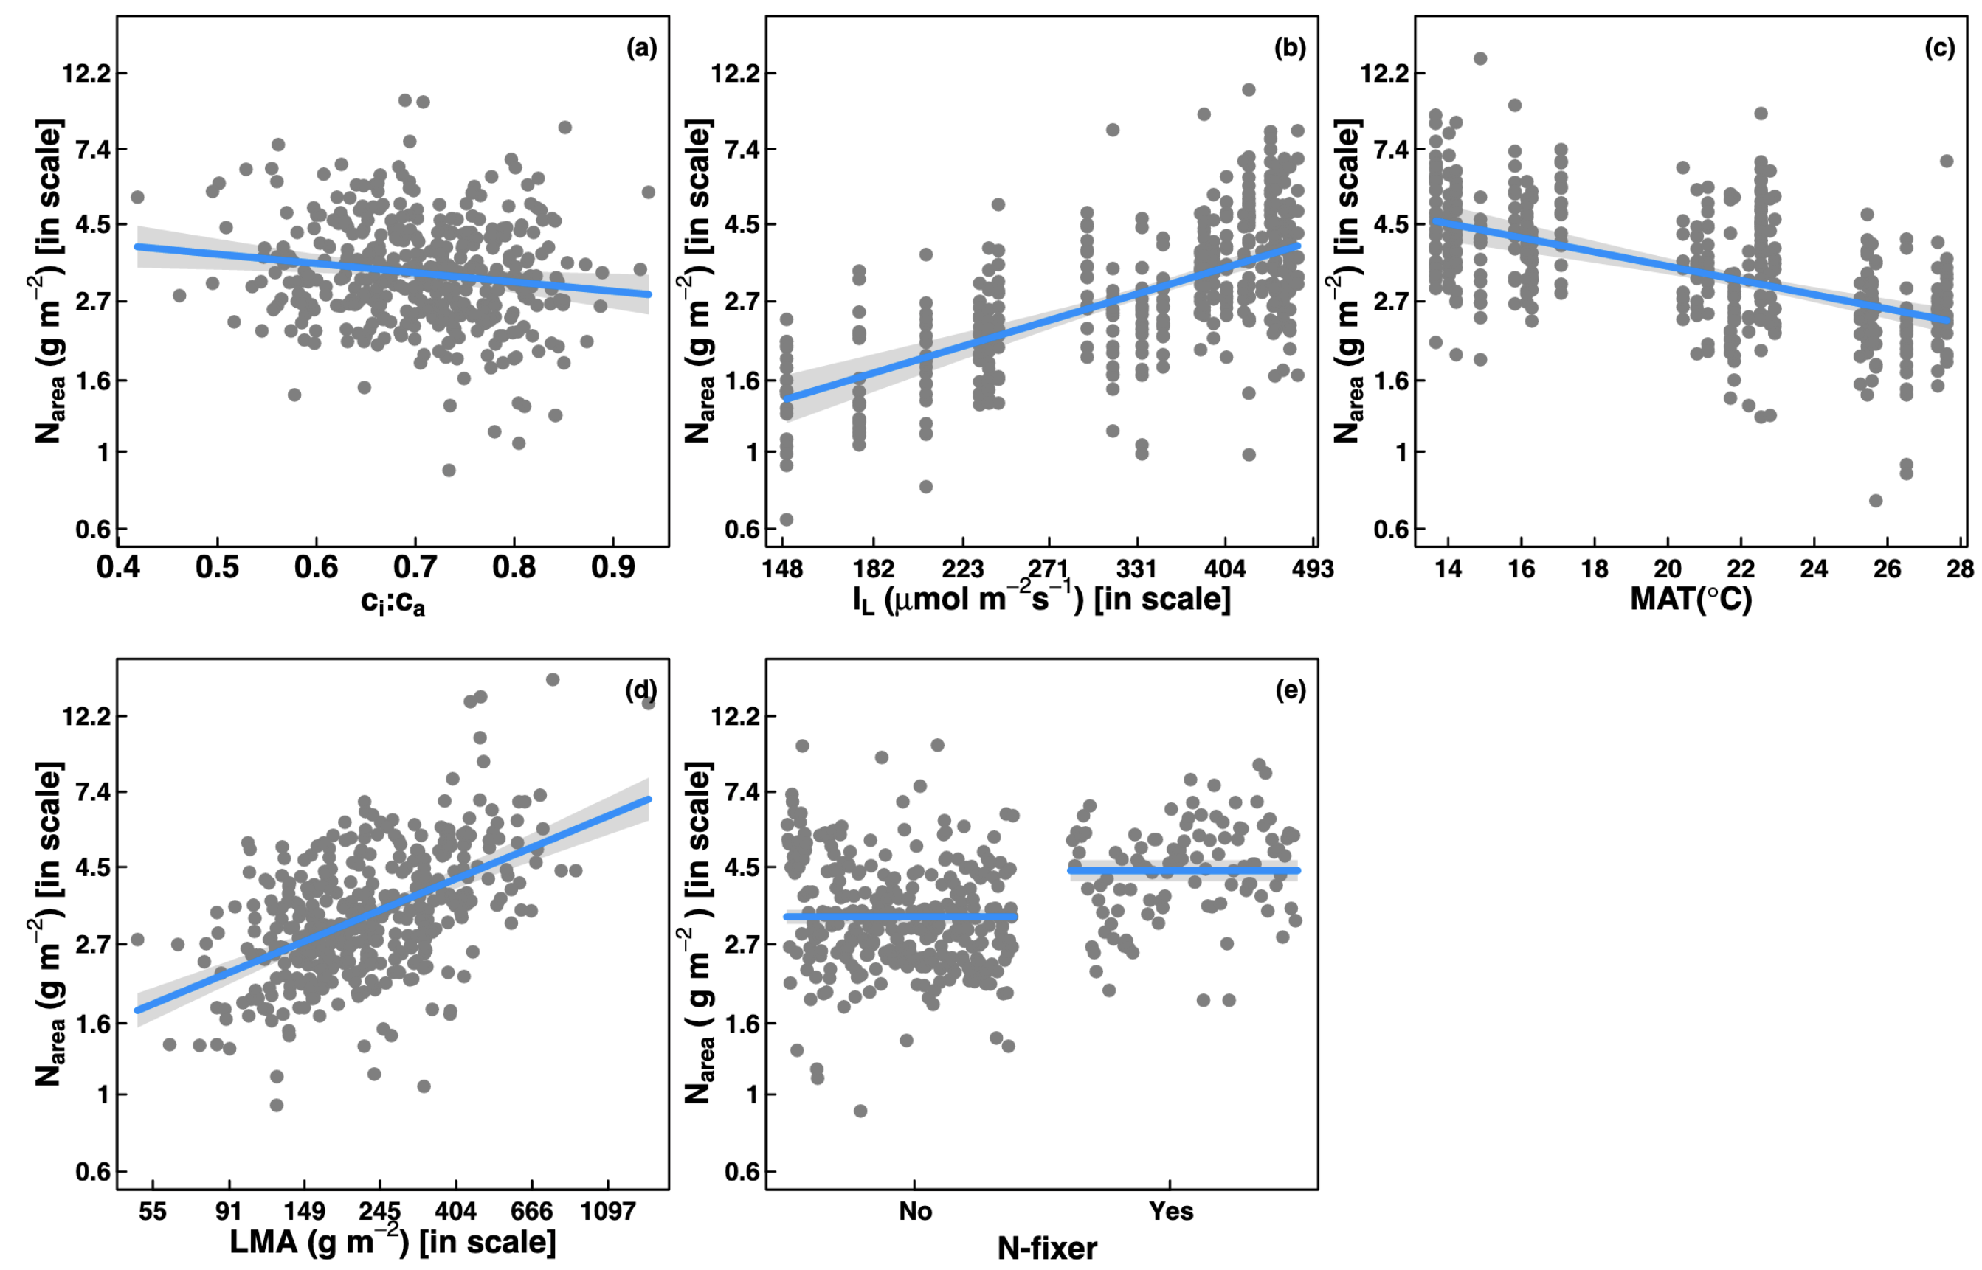
… but leaf nitrogen can be predicted independent of soil nitrogen
Dong et al. (2017) Biogeosciences
Notes:
Some recent work has also shown that leaf nitrogen can be predicted independent of soil nitrogen availability
This is work from Ning Dong showing on the top row in panel b and c that leaf nitrogen can be predicted from photosynthetically active radiation, which is basically light, and mean annual temperature.
Additionally, they show in panel a that leaf nitrogen can be predicted by the ratio of intercellular carbon dioxide to extracellular carbon dioxide, or Ci:Ca,
In panel d, they show that leaf nitrogen can be predicted through the ratio of intercellular carbon dioxide to atmospheric carbon dioxide, and in panel e show that leaf nitrogen can be predicted on the basis of whether a species can associate with nitrogen-fixing bacteria
Thus, aboveground climate and leaf traits can be used to predict patterns of leaf nitrogen

Slide 5
Leaf N is likely a product of interactions between climatic and edaphic factors
Notes:
While we know that variation in leaf nitrogen can be explained by soil nitrogen availability, climate, or plant traits, we still do not have a firm grasp of what drives leaf nitrogen content.
It is possible that these patterns are driven by plant allocation responses to soil nitrogen and climate, but we lack data that links these responses to physiological processes that range from the leaf to whole plant level
Yet, we do not fully understand when and where soil nitrogen impacts nitrogen allocation to leaf tissue vs. other tissues

Slide 6
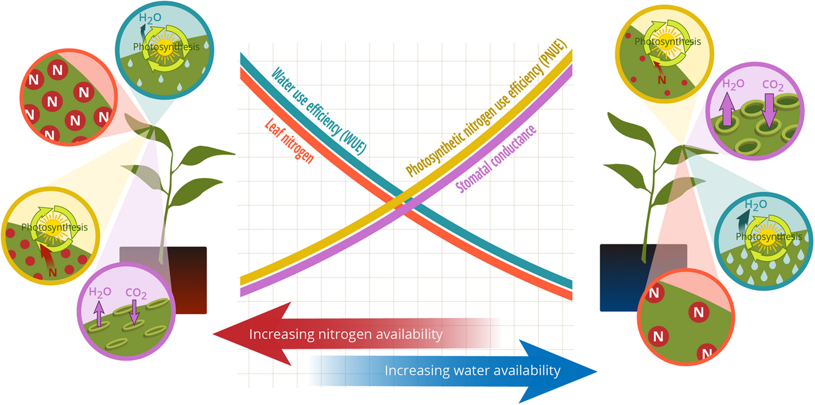
Photosynthetic ‘least-cost’ theory: leaves acclimate to changing climatic and edaphic environments based on summed costs of resource use
Bialic-Murphy et al. (2021) Ecology Letters
Notes:
At the leaf level, plants might allocate nitrogen to photosynthetic leaf tissue in order to preserve water
This option can be explained through recent frameworks suggesting that plants can and should maximize photosynthetic carbon gain by trading inefficient use of an abundant resource for efficiency a more limited limiting resource.
For example, if nitrogen is relatively more available than water, then plants can maintain a similar photosynthetic output by increasing nitrogen allocation toward photosynthetic leaf tissue in order to increase water-use efficiency., effectively employing a water-savings mechanism
We might expect these patterns would be observed in arid systems where water is relatively less available than nitrogen, although these patterns haven’t necessarily been tested in temperate regions

Slide 7
Photosynthetic ‘least-cost’ theory: leaves acclimate to changing climatic and edaphic environments based on summed costs of resource use
Bialic-Murphy et al. (2021) Ecology Letters
Notes:
At the leaf level, plants might allocate nitrogen to photosynthetic leaf tissue in order to preserve water
This option can be explained through recent frameworks suggesting that plants can and should maximize photosynthetic carbon gain by trading inefficient use of an abundant resource for efficiency a more limited limiting resource.
For example, if nitrogen is relatively more available than water, then plants can maintain a similar photosynthetic output by increasing nitrogen allocation toward photosynthetic leaf tissue in order to increase water-use efficiency., effectively employing a water-savings mechanism
We might expect these patterns would be observed in arid systems where water is relatively less available than nitrogen, although these patterns haven’t necessarily been tested in temperate regions

Slide 8
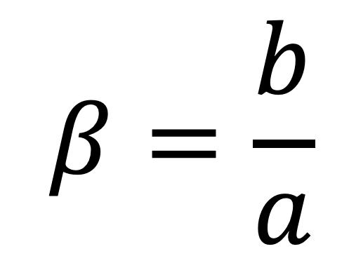
Resource unit cost ratio (β)
$$β=\frac{b}{a}$$

Slide 9
Resource unit cost ratio (β)
cost of acquiring and using N
$$β=\frac{b}{a}$$

Slide 10
Resource unit cost ratio (β)
cost of acquiring and using N
$$β=\frac{b}{a}$$
cost of acquiring and using H₂O

Slide 11
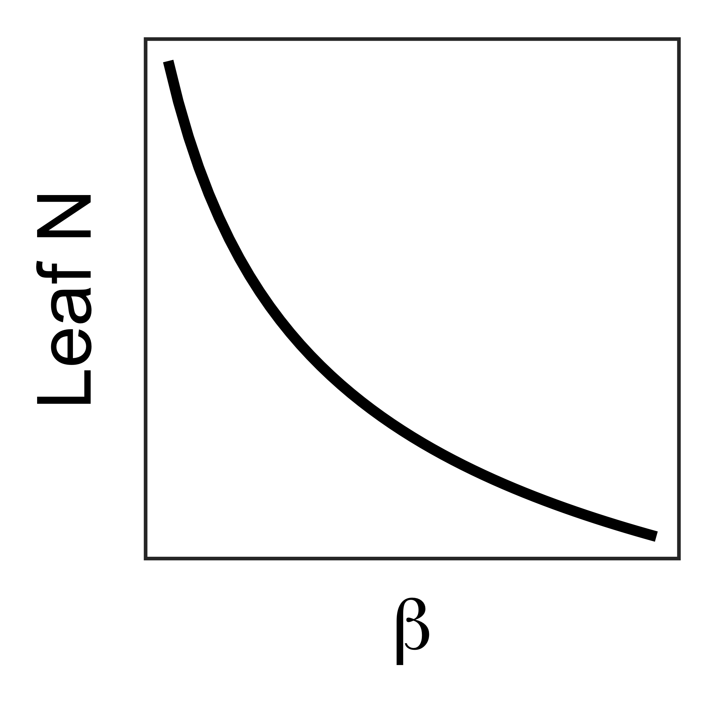
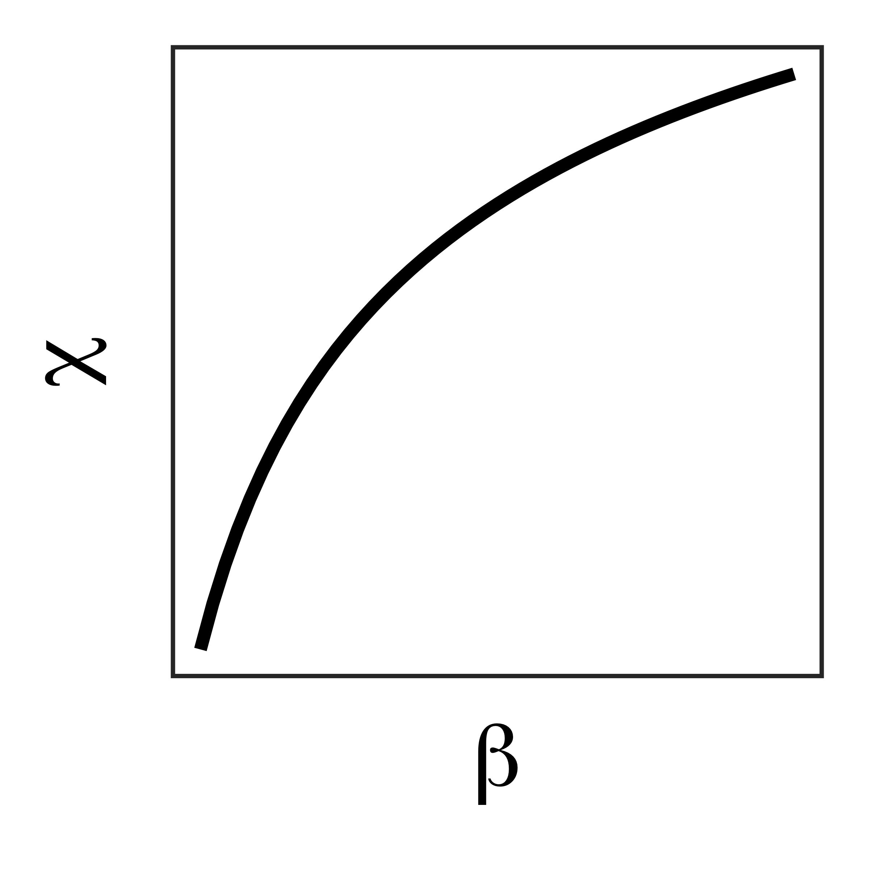

Slide 12
↑ N availability (less costly
to acquire/use)
↓ H₂O availability (more
costly to acquire/use)

Slide 13
↓ χ = ↓ water use = ↑ water use efficiency
↑ N availability (less costly
to acquire/use)
↓ H₂O availability (more
costly to acquire/use)

Slide 14
Hypothesis 1a: Soil nitrogen availability should increase leaf N to maintain photosynthesis with greater WUE
↓ χ = ↓ water use = ↑ water use efficiency
↑ N availability (less costly
to acquire/use)
↓ H₂O availability (more
costly to acquire/use)

Slide 15
Hypothesis 1b: Aridity/dryness should increase leaf N to maintain photosynthesis with greater WUE
↓ χ = ↓ water use = ↑ water use efficiency
↑ N availability (less costly
to acquire/use)
↓ H₂O availability (more
costly to acquire/use)
Notes:
Expectation: increasing soil nitrogen availability should increase the positive effect of aridity on water-use efficiency and tradeoffs between nitrogen and water use

Slide 16
Hypothesis 2: Soil N availability should increase the positive effect of aridity on leaf N, WUE
↓ χ = ↓ water use = ↑ water use efficiency
↑ N availability (less costly
to acquire/use)
↓ H₂O availability (more
costly to acquire/use)
Notes:
Expectation: increasing soil nitrogen availability should increase the positive effect of aridity on water-use efficiency and tradeoffs between nitrogen and water use

Slide 17
Leaf N/χ responses to β may depend on species identity traits

Slide 18
Study sites, collection methods, traits
3 leaves of 5 most dominant species at each site
Leaf N (gram/area basis)
Leaf LMA
Leaf δ¹³C (χ, β)
Composite soil sample
[NO₃-N]

Slide 19
Site climatic
characteristics
Site edaphic
characteristics
Extracted from PRISM gridded product @ 4km resolution:
2006-2020 MAP/MAT
Daily precipitation, temperature, VPD from 30 days leading up to property visit
Collected from composite soil sample:
[NO₃-N]
pH
Texture (% silt, clay, sand)
Estimated using SPLASH v1.0 bioclimatic model:
Relative soil moisture (based on 150mm bucket)

Slide 20
Site climatic
characteristics
Site edaphic
characteristics
Extracted from PRISM gridded product @ 4km resolution:
2006-2020 MAP/MAT
Daily precipitation, temperature, VPD from 30 days leading up to property visit
Collected from composite soil sample:
[NO₃-N]
Estimated using SPLASH v1.0 bioclimatic model:
Soil moisture (based on 150mm bucket size)

Slide 21
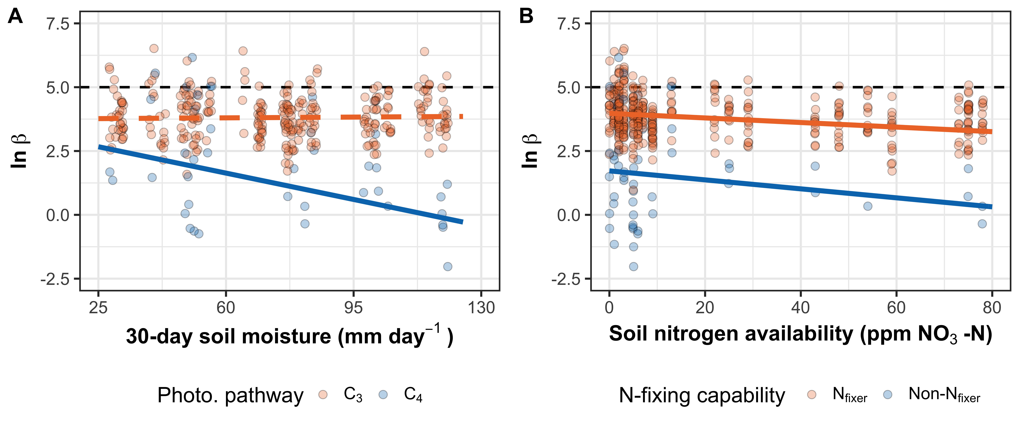

Slide 22
β decreases with increasing soil moisture in C₄ species, but not C₃ species

Slide 23
β decreases with increasing soil N regardless of N-fixing capability, N-fixing species have higher β

Slide 24
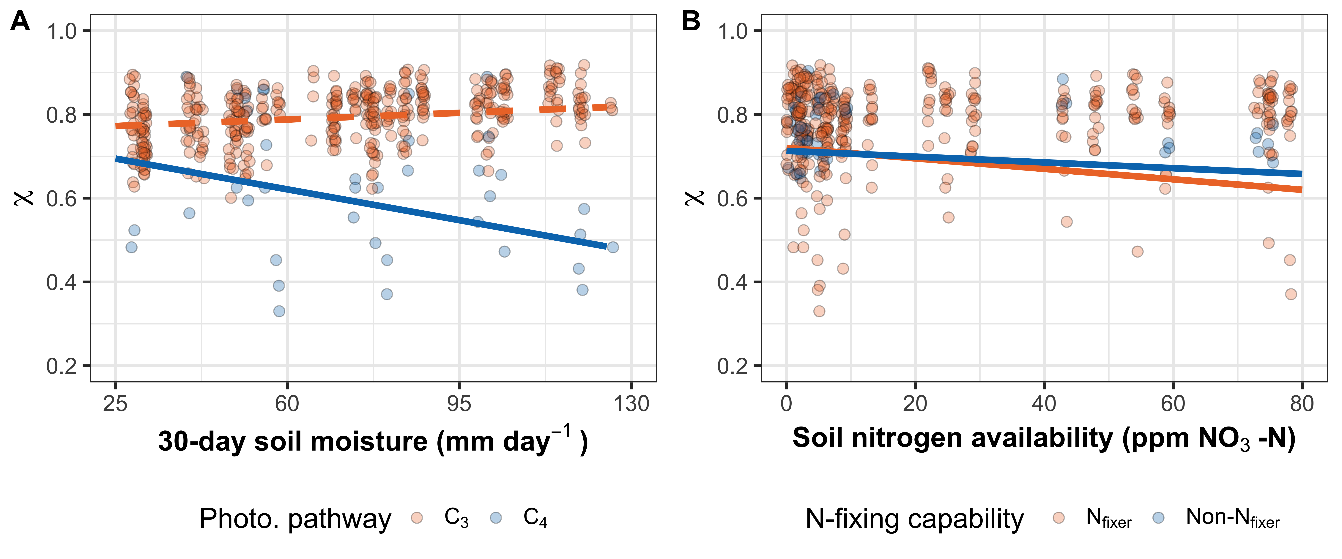
χ decreases with increasing soil moisture in C₄ species, but not C₃ species

Slide 25
χ decreases with increasing soil N regardless of N-fixing capability

Slide 26
Leaf N decreases with increasing β, but is unaffected by changes in χ

Slide 27
No effect of

Slide 28
Main takeaways
β generally increased with
β values much more variable than single stagnant value of 146- supports need to include β dynamically in PLCT models
χ

Slide 29
Thank you!
Slides are available at [insert URL here]

Slide 30
Extra slides

Slide 31
Resource unit cost ratio (β)
cost of acquiring and using N
$$β=\frac{b}{a}$$
cost of acquiring and using H₂O

Slide 32
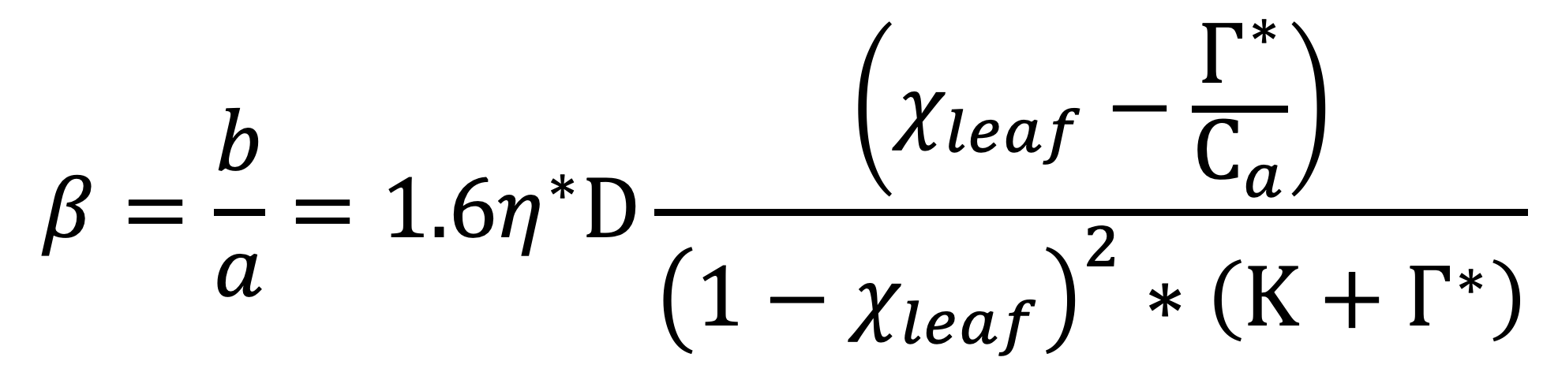
Resource unit cost ratio (β)
$$β=\frac{b}{a}=1.6η^{∗}D\frac{\left(χ_{leaf}−\frac{Γ^{∗}}{C_{a}}\right)}{{\left(1−χ_{leaf}\right)}^{2}∗\left(Κ+Γ^{∗}\right)}$$
Notes:
We used the following field manipulation experiment to investigate whether changes in soil resource availability influenced leaf quantity/quality tradeoffs or water/nitrogen use tradeoffs.
Starting in 2010, our coauthor Christy Goodale set up a full-factorial nitrogen-by-sulfur field manipulation experiment at three sites in a contiguous closed canopy forest all within a 20-km radius of Ithaca, New York
This experiment was originally created to tease apart the impacts of soil pH change and soil nitrogen fertilization on forest ecosystem functions;
however, because sulfur additions acidify the soil and promote nitrogen losses over time, this system provides a unique soil nitrogen availability gradient to test our hypotheses

